Slide 1
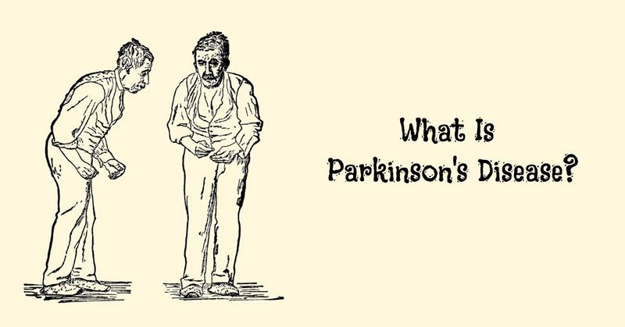
Introduction of the project group 1
Parkinson’s disease is a neurodegenerative, progressive disorder of the central nervous system that affects movement and causes tremors and stiffness
Detecting Parkinson’s disease using Vocal Data from Patients.
By using dysphonia data were taken from both healthy and patients with Parkinson's disease
Using calibrated and verified measurement procedures to detect speech signals
Using a Multi-Dimensional Voice Program (MDVP) as the primary of recording the phonations
Problem description
Recently, researchers have begun to utilize data science to improve healthcare and services – predicting diseases early will have countless advantages on the prognosis.
In our study, we are using Vocal test results, we use 24 different vocal Phonation such as Jitter, Shimmer, Harmonics to noise ratio etc.
We minimize these attributes using different statistical techniques to find out which of the attributes are most likely dependent on the final status of the patient, these techniques are going to be discussed in the next slides.
https://www.parkinsonmn.org/get-support/patient-resources/parkinsons-disease-101/

Slide 2
Assumptions for the Project Data
The measurements detected by the equipment are properly measured.
The doctor’s diagnosis is assumed to be correct.
All the testing equipment are in the best working conditions.
Testing machines are properly calibrated as per prescribed guidelines.
All the standards and SOP’s are followed during the testing of patients.
All the designated staff are properly trained for utilizing the testing equipment at its best working condition.
Limitations
The data used for analysis is limited i.e. limited patients under observation.
The measuring equipment has limitations on measuring the values.
Limited access to the patient's medical history, therefore we can’t use any other information.
Project team members are limited to work on the data as available in the file.

